Slide 1


A Framework to Make Voting System Transparent Using Blockchain Technology
PRESENTED BY:-
GAURAV JADHAV GUIDE:
AAKASH DESALE PROF. SATISH MANJE
NITESH SAWARDEKAR

Slide 2
Introduction
As elections are a vital part of any democratic society, it is essential to ensure a fair and transparent voting process. Our framework aims to utilize blockchain technology and face recognition to address the existing challenges in the current voting system.

Slide 3

Aims and Objectives
Enhance Transparency
2
Strengthen Security
Streamline Voting Process
1
3
Implement a system that provides transparency in the entire voting process, ensuring trust among citizens.
Utilize advanced face recognition algorithms and blockchain technology to minimize vote tampering and identity fraud.
Create a user-friendly interface that simplifies the voting process and reduces administrative burdens.

Slide 4
Existing System
Identity Verification Challenges
Paper-Based Voting
Lack of Transparency
Current systems often rely on paper ballots, making it prone to errors, tampering, and inefficient manual counting.
Voter impersonation and identity fraud remain significant issues, compromising the integrity of the voting system.
The lack of a centralized and auditable system makes it difficult to ensure transparency, leading to doubts about election fairness.

Slide 5

Problem Statement
The existing voting systems suffer from vulnerabilities such as lack of transparency, security risks, and inefficient processes. We aim to address these problems and provide a reliable solution.

Slide 6

Importance of Transparency in the Voting System
1
Trustworthy Elections ✅
Transparent voting systems are crucial to ensure fair elections and maintain public trust in democratic processes.
2
Accountability & Oversight 📊
Transparency allows for effective oversight, allowing stakeholders to verify the accuracy and legitimacy of election results.
3
Public Confidence & Participation 🗳️
Transparent voting systems encourage citizens to actively participate in the democratic process, leading to increased voter turnout.

Slide 7

Scope
1
National Elections
Our framework is designed to be scalable and can be implemented in national-level elections with millions of voters.
2
Local Elections
The framework is adaptable and can also be utilized in local and regional elections to ensure fairness and transparency.
3
Secure Online Voting
The system can facilitate secure online voting, making it convenient for voters who cannot physically visit polling stations.

Slide 8
Proposed System
1
Face Recognition with KNN
Integrate face recognition algorithms, such as K-Nearest Neighbors (KNN), to ensure accurate identity verification.
2
Blockchain Technology
Utilize blockchain to create an immutable and transparent ledger, recording all voting transactions securely.
3
SHA-256 Algorithm
Implement SHA-256, a secure hash algorithm, for encrypting and protecting the integrity of voting data stored on the blockchain.

Slide 9


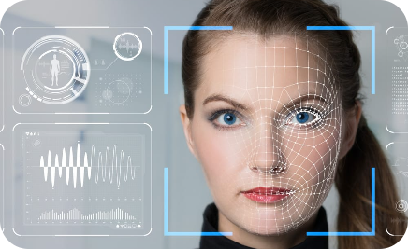
Voting App
A user-friendly mobile application will enable voters to cast their votes securely.
Blockchain Network
Face Recognition Server
The proposed system will consist of a distributed network of nodes, ensuring decentralization and data redundancy.
A dedicated server powered by advanced face recognition algorithms will authenticate voters.

Slide 10
Understanding Blockchain Technology for Transparency in Voting System
What is Blockchain?
Benefits of Blockchain in Voting System
Smart Contracts in Voting
Blockchain is a decentralized, immutable digital ledger that records transactions across multiple computers, ensuring transparency and security.
Smart contracts enable automated and self-executing voting processes, ensuring accuracy and reducing the need for intermediaries.
Blockchain provides a tamper-resistant and auditable record of votes, eliminating the possibility of unauthorized alterations or fraud.

Slide 11

Face Recognition using KNN Algorithm in the Voting System
1
Facial Biometrics Technology
Face recognition technology uses unique facial features to identify individuals, providing an extra layer of security in the voting system.
2
What is K-Nearest Neighbors (KNN) Algorithm?
KNN Algorithm is a machine learning technique that classifies objects based on similarities in features. It is used to match faces during voting authentication.
3
Integration of Face Recognition
By integrating face recognition using the KNN algorithm, the voting system can ensure accurate identification and prevent fraudulent activities.

Slide 12



System Architecture
Admin
User
Add Election
Register
Upload image
Verify User
Trained Image
Publish Result
Vote for Candidate
Face Verification
Register Vote
Result

Slide 13
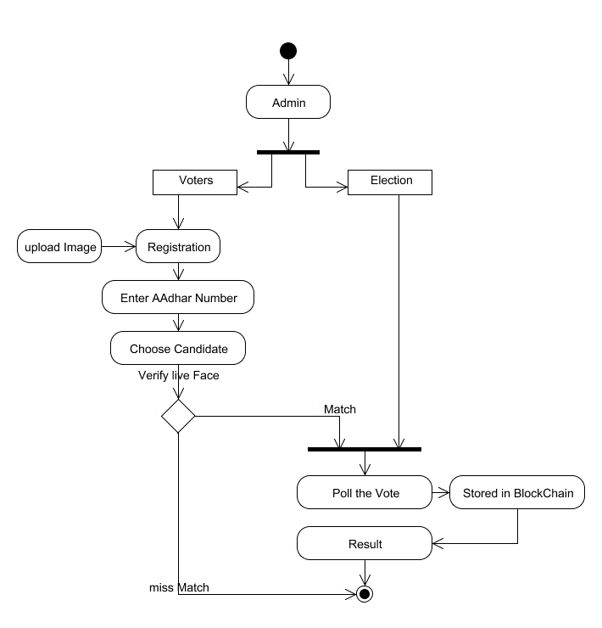
METHODOLOGY

Slide 14

Advantages
Transparency
The blockchain-based system ensures transparency, allowing voters to track their votes securely.
Security
Face recognition technology and blockchain encryption protect against identity fraud, hacking, and tampering.
Efficiency
The streamlined voting process saves time, reduces errors, and simplifies the overall election administration.

Slide 15
Challenges and Considerations in Implementing the Framework
1
Privacy Concerns and Data Protection
Strict measures must be in place to ensure the privacy of voters' personal information and protect against unauthorized access.
2
Training and Accuracy of Face Recognition System
Face recognition algorithms need to be continuously trained and refined to ensure accurate identification and eliminate potential biases.

Slide 16
Next Sem Implementation
Working on Face Recognition using KNN Algorithm and add Backend using of SHA-256 Algorithm for Blockchain Technology for E-voting counting And other feature of Blockchain Technology . To Connect GUI and the Backend . Testing of whole project and its Feature .

Slide 17
Thank You!

